Slide 1




Intro to CTF
Cyberhax{th1s_1s_wh3r3_y0ur_j0urn3y_b3g1n5}

Slide 2
01
04
02
05
Table of Contents
03
06
Overview
Web Exploitation
What is a CTF?
What is the goal?
What are the tools used?
What are some of the techniques?
Categories of CTF
OSINT
How many categories?
What are the differences?
What are the tools used?
What are some of the techniques?
Types of Challenges
Mini CTF
How many types?
What are the differences?
Prove to the world your potential!

Slide 3
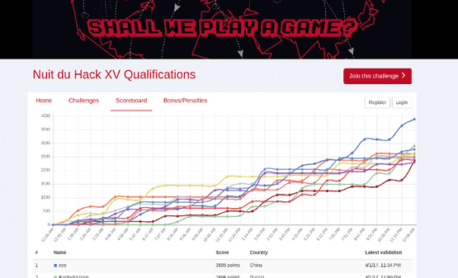
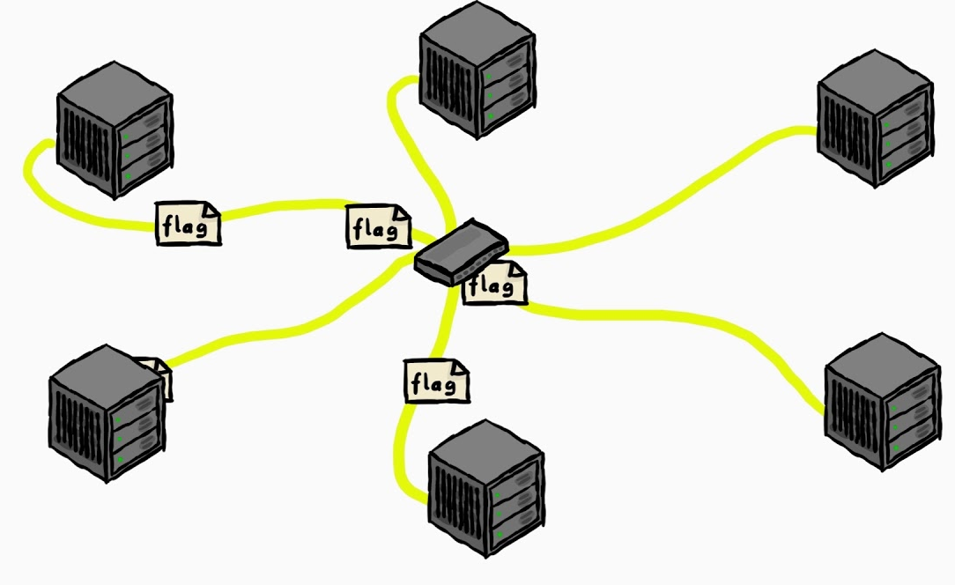
Overview of CTF
CTF stands for Capture the Flag, and it's essentially a cybersecurity competition wrapped in a puzzle-solving game.
Participants, whether individuals or teams, compete to find hidden pieces of text called "flags" within various challenges.

Slide 4

Categories of CTF
Jeopardy
Attack / Defense
Mixed
Most common type of CTF.
Teams / individuals tackle challenges in any order, and each challenge is worth a certain number of points.
Most points wins.
Teams are given their own network infrastructure, which they must defend from attacks by other teams.
They must also find and exploit vulnerabilities in the other teams' networks to score points.
Mixture of both jeopardy-style and attack-defense CTF.

Slide 5
Types of Challenges
Binary Exploitation
Forensics
Reverse Engineering
AKA pwn.
Somehow breaks binaries/executables to execute what was not intended by the developer.
Buffer overflow, return-oriented programming, etc.
Analyzing data to uncover hidden information and solve mysteries.
Memory forensics, steganography, malware analysis, network forensics, etc.
Cracking codes/crypto algorithms and manipulating encrypted messages.
Block cyphers, hashing, symmetric & asymmetric key crypto, etc.

Slide 6
Types of Challenges
Cryptography
Fullpwn
Miscellaneous
AKA Boot2Root.
Combining all techniques of hacking from all types of challenges to gain user & root access of a server.
HackTheBox, etc.
Cracking codes, mainly reversing crypto algorithms to retrieve flags.
Block cyphers, hashing, symmetric & asymmetric key crypto, etc.
Challenges that do not specifically fit into any of the categories but are related to information security.

Slide 7
Types of Challenges
Web Exploitation
OSINT
Finding and using vulnerabilities in websites or applications to retrieve the flag.
Cross-site scripting, cross-site request forgery, SQL injection, remote code execution, etc.
Stands for open-source intelligence.
Using information provided on the internet to solve the puzzles.

Slide 8
Steps of Solving
Step 1
Step X
Reconnaissance
???
Step 2
Steps N
???
Submit flag!
All Steps
Document Findings

Slide 9
Tools We will Use
Web browser (recommended to use Chromium-based or Firefox)
Text editor (recommended to use VS Code)
Burp Suite Community Edition
Kali Linux (recommended)
Sherlock (pre-installed on Kali)
Web browser (recommended to use Chromium-based or Firefox)
Stalking Skills
Web Exploitation
OSINT

Slide 10

CTF Exercise
Walkthrough to solve web exploitation and OSINT challenges

Slide 11
Mini CTF
Cyberhax{pr0v3_yu0r_p0t3nt1al!}

Slide 12
Thanks
Do you have any questions?
ammar_22006911@utp.edu.my
+60 12-578 2604
https://github.com/FROST8ytes
@cyberhaxutp

